Slide 1
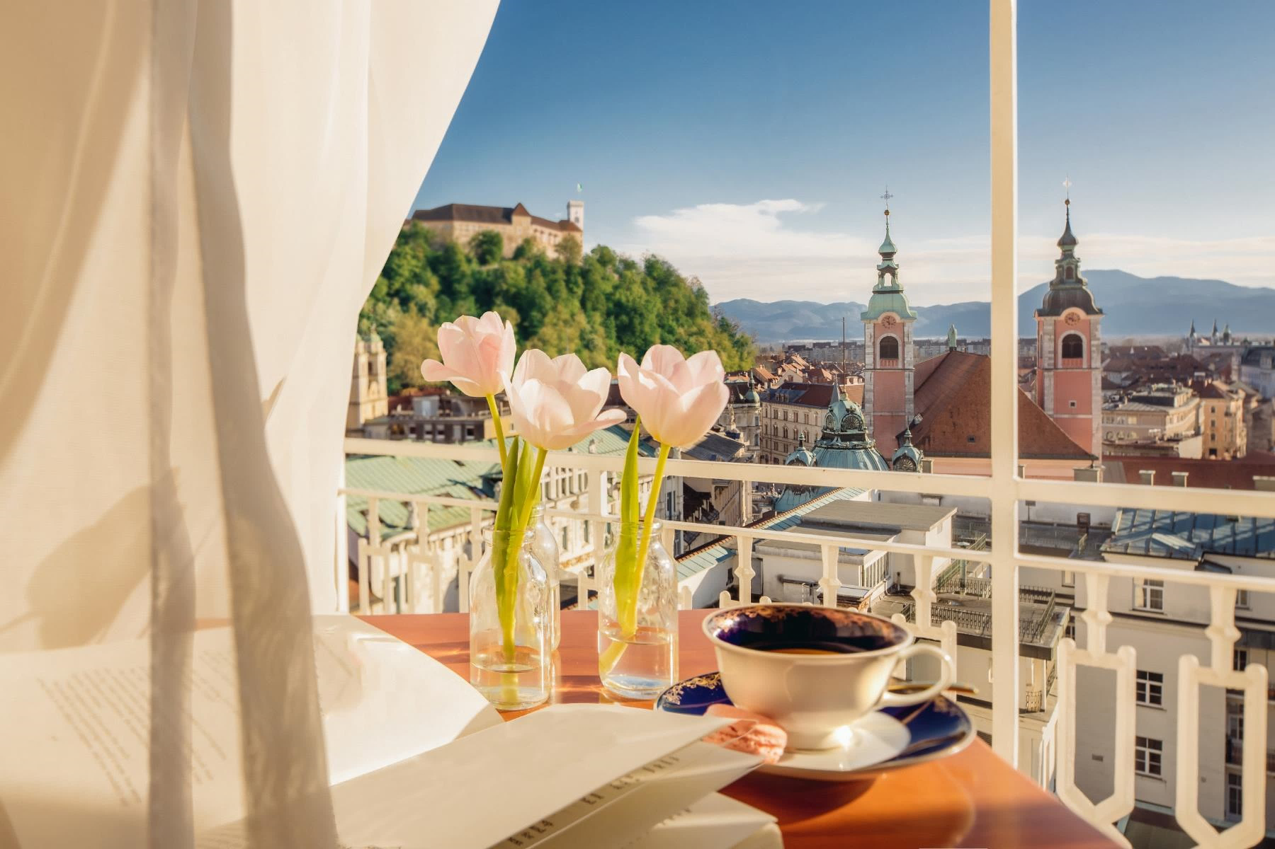
UNION HOTELS COLLECTION
Ljubljana – Slovenija
WWW.UHCOLLECTION.SI

Slide 2
UNION HOTELS • IN THE CITY CENTRE OF LJUBLJANA • SLOVENIA
4 HOTELS
with different concepts, all on a top location in the city centre of Ljubljana
636 HOTEL ROOMS
elegantly furnished hotel and in various categories
+ 20 FUNCTION ROOMS
equipped to cater conferences, business meetings and important social events
Secured parking facilities
Unique culinary experience
More than 1000 successful events per year
Attentive & professional staff

Slide 3
UNION HOTELS • IN THE CITY CENTRE OF LJUBLJANA • SLOVENIA
ANNOUNCING FOR SPRING 2020
Grand Hotel Union - refurbishement of the first floor
9 Superior Comfort Doubles/Twins
10 Grand Deluxe Doubles/Twins
3 Junior Suite
1 Residence Two Bedroom Suite
1 Grand Corner Suite
1 Grand Union Suite
uHotel – addition of 4 new accomodations
3 Executive Doubles/Twins
1 Junior Suite
Hotel Lev – addition of 22 new accomodations
22 Premier Doubles/Twins
The Fuzzy Log – new concept
101 additional accomodations

Slide 4
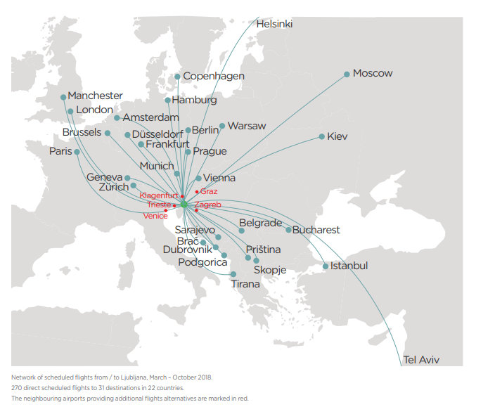
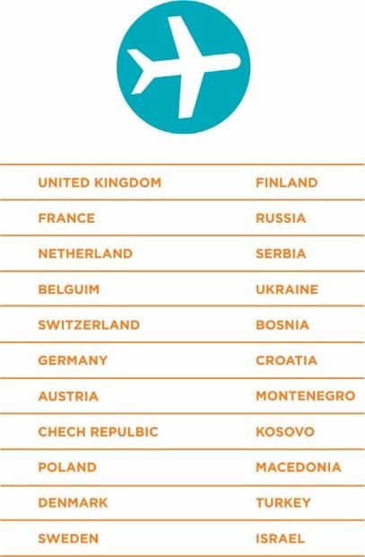
LJUBLJANA • PERFECT LOCATION IN CENTRAL EUROPE
DIRECT FLIGHTS TO JOŽE PUČNIK AIRPORT (LJU)
TIME ZONE: GMT + 1
Notes:
Razdalje

Slide 5
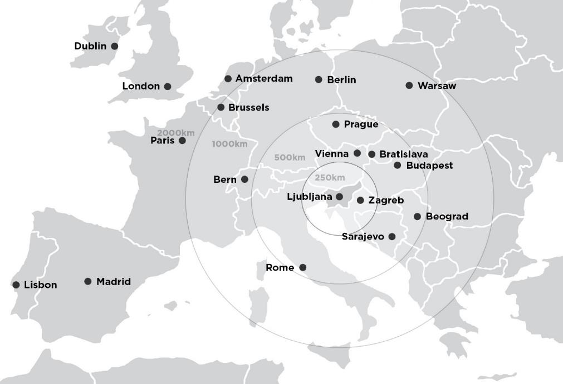
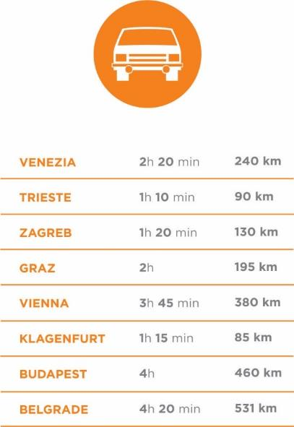
LJUBLJANA • PERFECT LOCATION IN CENTRAL EUROPE
DISTANCE TO LJUBLJANA FROM NEAREST MAJOR CITIES
Notes:
Travelling by car around Slovenia is very straightforward, with the roads clearly and well signposted. Some local roads can get a little narrow and winding, but for all that they are pleasant and interesting. There are plenty of petrol stations. And if you want to get to the other end of the country in a hurry, you can take the motorways, for which you need a vignette.
Slovenia lies in central Europe, and borders Italy, Austria, Croatia and Hungary. It is just a few hours’ travel from Venice or Vienna. Slovenia is easy to reach from neighbouring countries, with good road and rail links, and daily flights from numerous European cities. As a maritime nation, Slovenia can also be reached by sea. How to get to Slovenia by all the different means of transport is described in detail in individual columns. Some basic information is given here.

Slide 6
EXPERIENCE SLOVENIA • THE SEA AND MOUNTAINS
LAKE BLED
IZOLA
Notes:
Razdalje

Slide 7
EXPERIENCE SLOVENIA • THE WEALTH OF NATURE AND SIMPLICITY OF LIFE
SOČA RIVER
MOUNTAIN VILLAGES
LIPIZZAN HORSES
Notes:
Razdalje

Slide 8
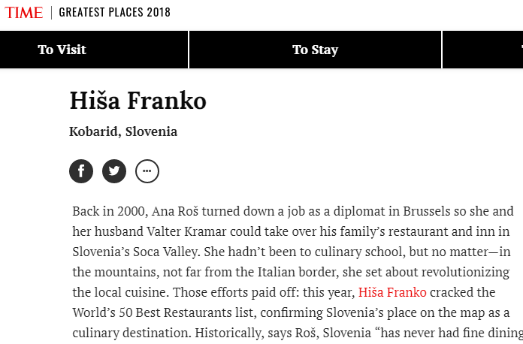
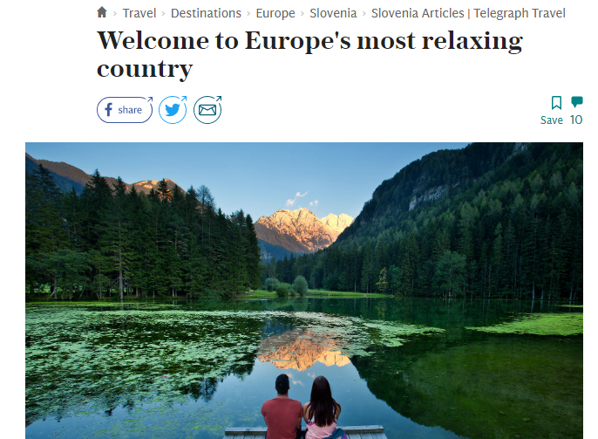
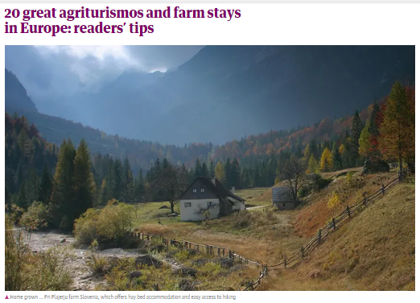
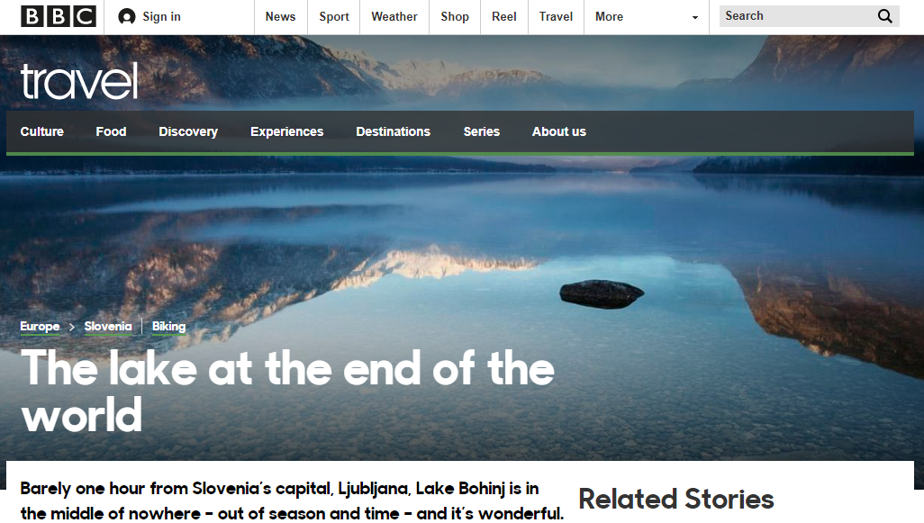
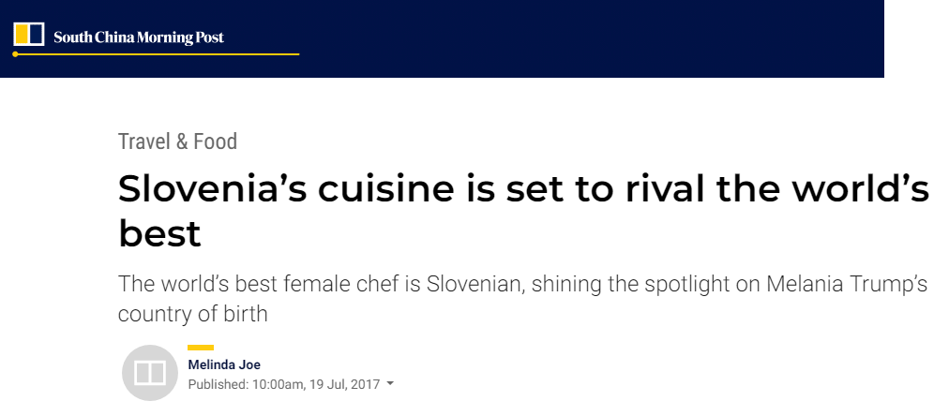
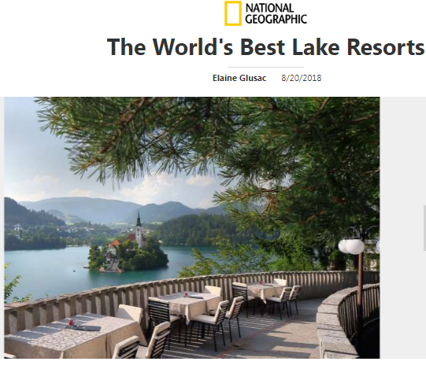
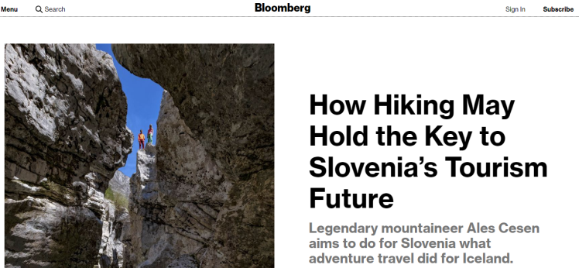
Highlights from global press
EXPERIENCE SLOVENIA • HIGHLIGHTS FROM GLOBAL PRESS

Slide 9
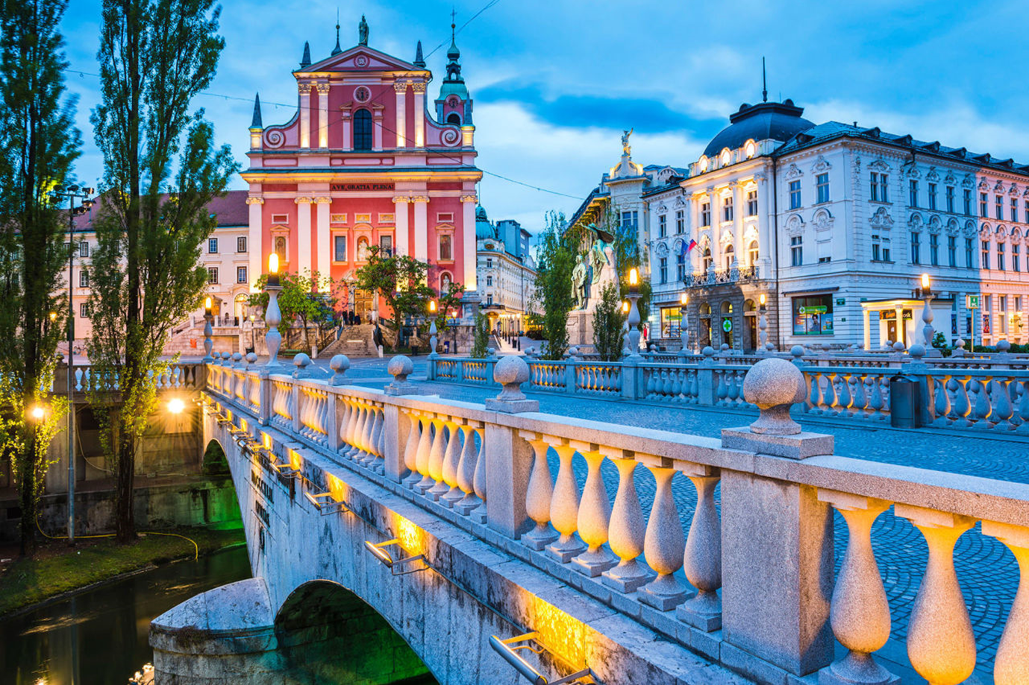
UNION HOTELS • IN THE CITY CENTRE OF LJUBLJANA • WHAT TO SEE
THE FIRST EUROPEAN GREEN CAPITAL IN CENTRAL AND SOUTHEAST EUROPE
PREŠEREN SQUARE,TRIPLE BRIDGE
Notes:
Ljubljana attractions

Slide 10
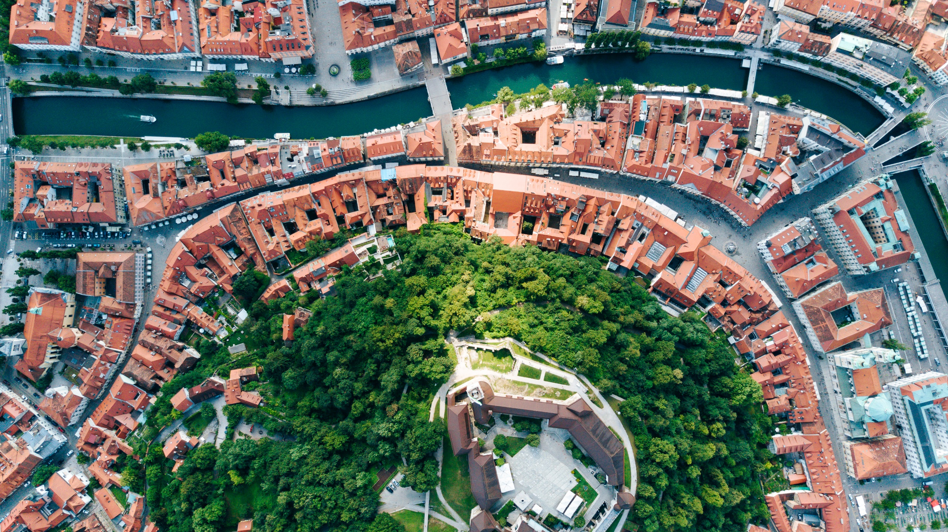
UNION HOTELS • IN THE CITY CENTRE OF LJUBLJANA • WHAT TO SEE
1 min walk from GRAND HOTEL UNION and uHOTEL • 8 min walk from HOTEL LEV • 5 min walk from CENTRAL HOTEL
HISTORICAL TOWN, PEDESTRIAN AREA

Slide 11
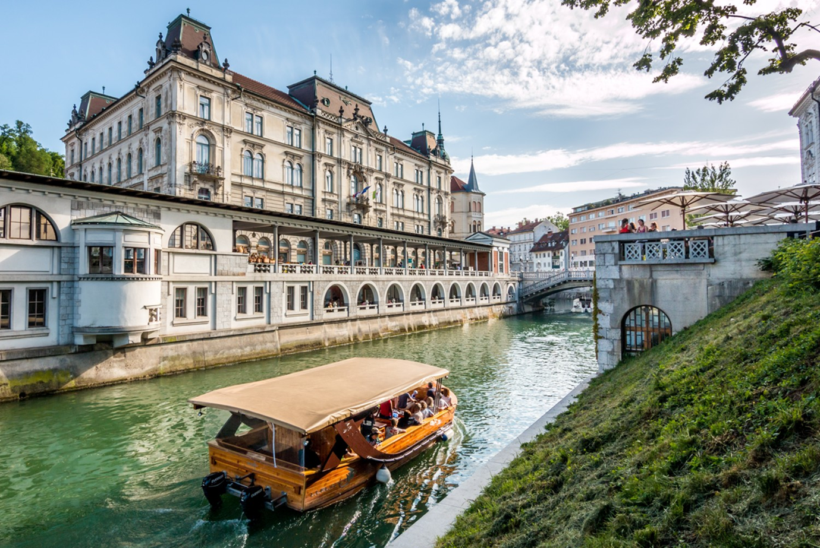
UNION HOTELS • IN THE CITY CENTRE OF LJUBLJANA • WHAT TO SEE
LJUBLJANIČA RIVER

Slide 12
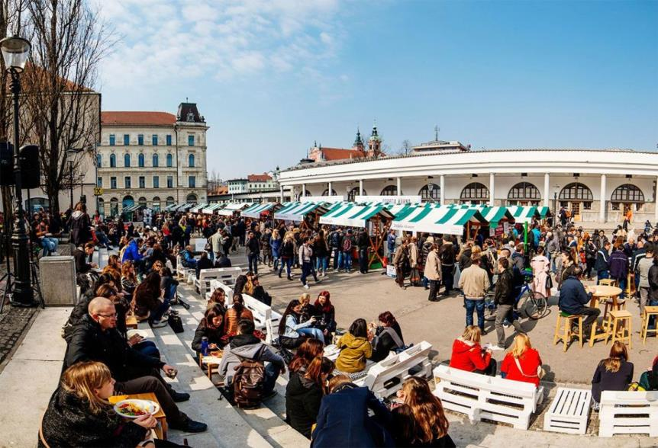
UNION HOTELS • IN THE CITY CENTRE OF LJUBLJANA • WHAT TO SEE
2
CENTRAL MARKET – ODPRTA KUHNA

Slide 13
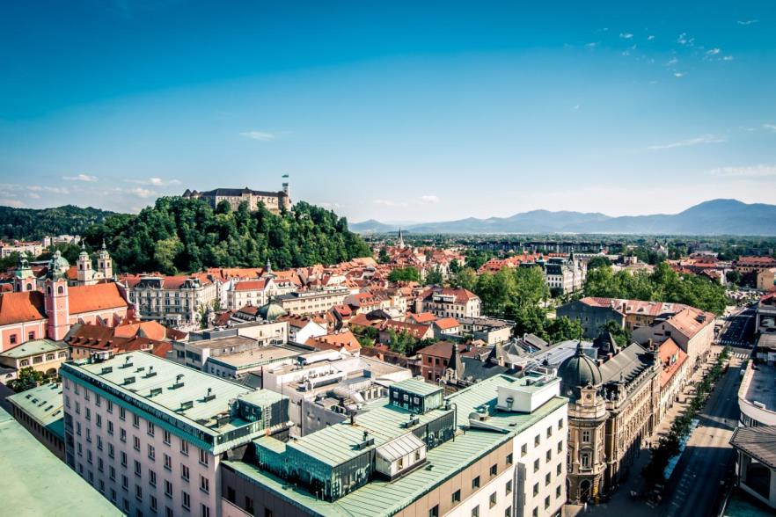
UNION HOTELS • IN THE CITY CENTRE OF LJUBLJANA • WHAT TO SEE
LJUBLJANA CASTLE

Slide 14
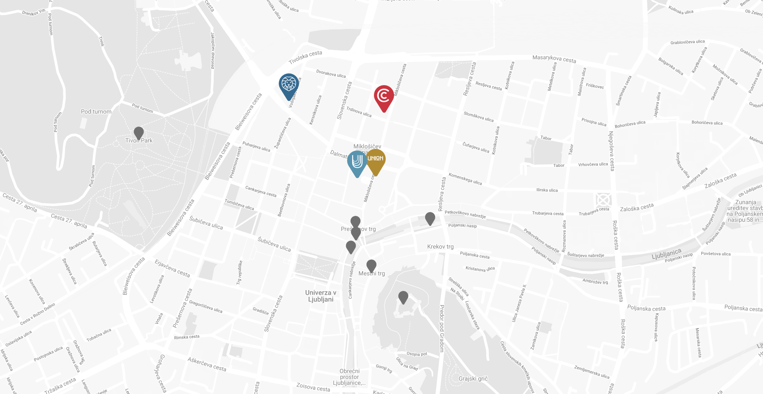
UNION HOTELS • IN THE CITY CENTRE OF LJUBLJANA • SLOVENIA
Main railway and bus station
HOTEL LEV
CENTRAL HOTEL
Tivoli Park
uHOTEL
GRAND HOTEL UNION
Prešeren Square & Triple Bridge
Dragon Bridge
Central market
Old Town
Ljubljana Castle

Slide 15
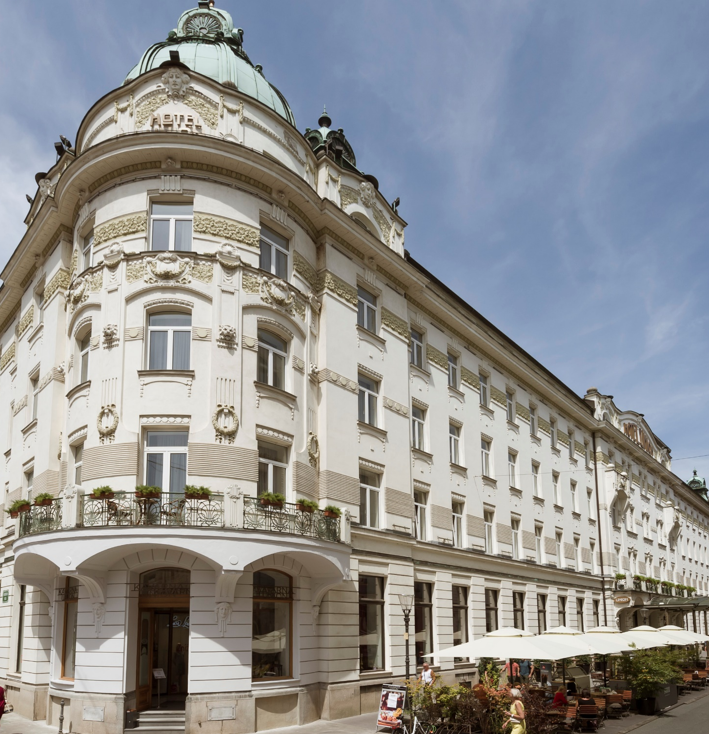
WELCOME TO THE GRAND HOTEL UNION • IN THE HEART OF THE CITY
www.grandhotelunion.si

Slide 16
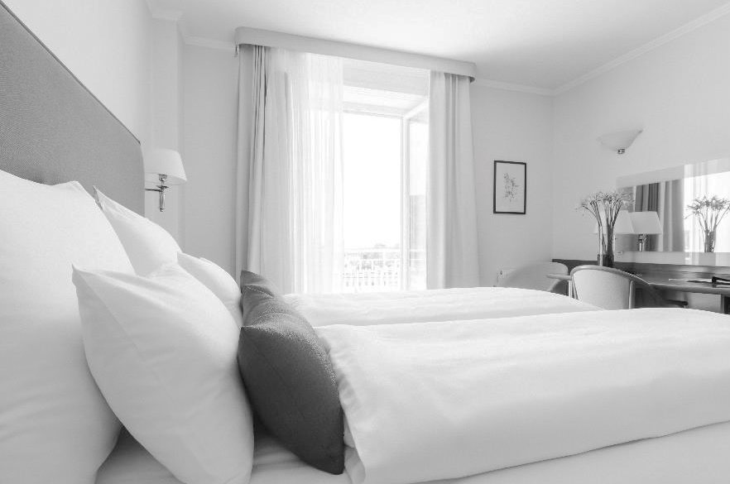
GRAND HOTEL UNION • IN THE HEART OF THE CITY
107 COMFORTABLE AND ELEGANTLY FURNISHED ROOMS
120 SECURED PARKING SPACES
18 CONFERENCE HALLS AND SALONS OFFERING OVER 2.200 m2
F&B OUTLETS WITH OUTSTANDING CHEFS
FULL AV SUPPORT & PROFESSIONAL STAFF

Slide 17
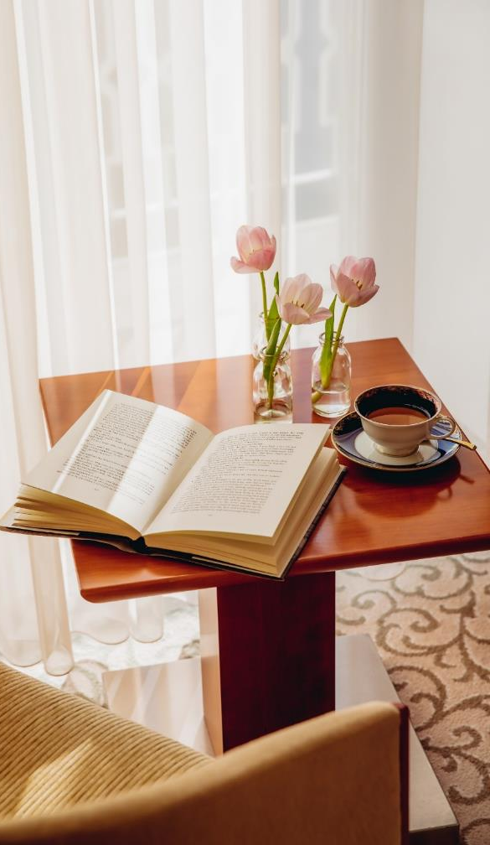
GRAND HOTEL UNION • ROOM TYPES
COMFORT ROOM (36)
DELUXE ROOM (56)
FAMILY TWO BEDROOM SUITE (3)
STUDIO APARTMENT (9)
CORNER SUITE (3)
21 ROOMS CURRENTLY BEING REFURBISHED

Slide 18
GRAND HOTEL UNION ROOMS • DECORATED WITH AN ETERNAL ELEGANCE
COMFORT ROOM average size is 23 SqM/247 SqFt.
Notes:
ROOM AMENITIES
COMFORT QUEEN
Rooms feature a full bed, comfortable working space, flat screen TV with international channels and WIFI.
COMFORT DOUBLE
Those on higher floors offer a balcony with beautiful view over Ljubljana castle or Alps. Rooms feature a king or twin bedding, comfortable working space, flat screen TV with international channels and WIFI.

Slide 19
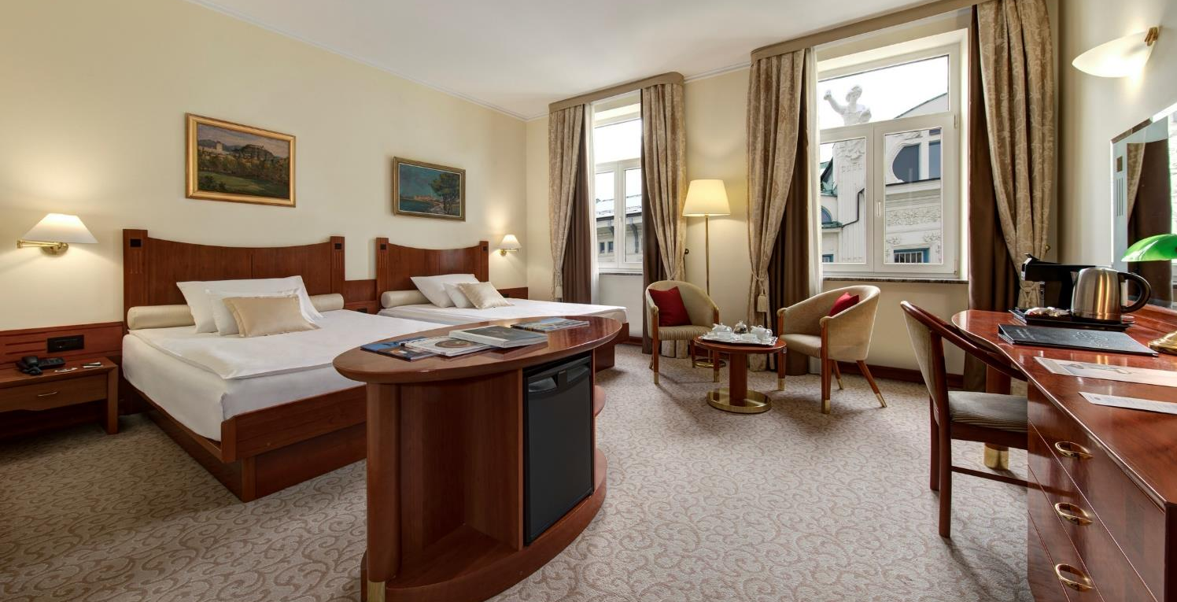
GRAND HOTEL UNION ROOMS • DECORATED WITH AN ETERNAL ELEGANCE
DELUXE DOUBLE / TWIN average size is 30 SqM/ 323 SqFt.
Notes:
ROOM AMENITIES
DELUXE DOUBLE
These rooms have elegant furnishing, comfortable working space, flat screen TV with international channels and WIFI.

Slide 20
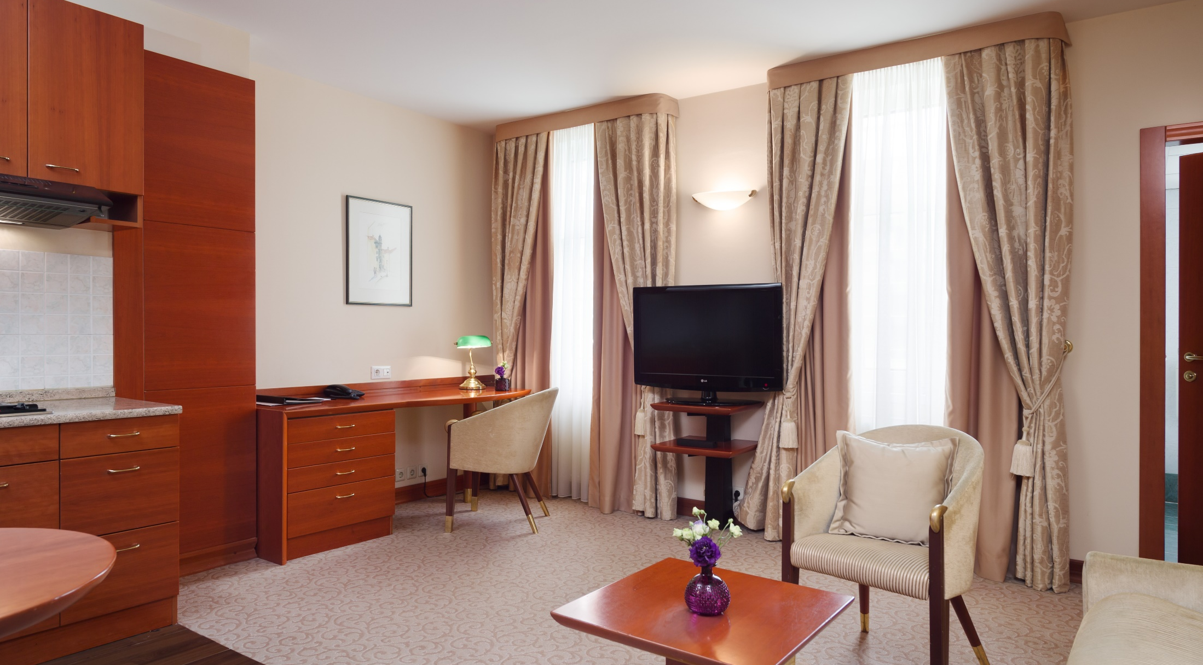
GRAND HOTEL UNION ROOMS • DECORATED WITH AN ETERNAL ELEGANCE
STUDIO APARTMENT average size is 36 SqM/ 387 SqFt.
Notes:
STUDIO AMENITIES
These apartments feature a little kitchenette, living room with working area, bedroom with double bed and private bathroom. All studios are offering flat screen TV with international channels and WIFI.

Slide 21
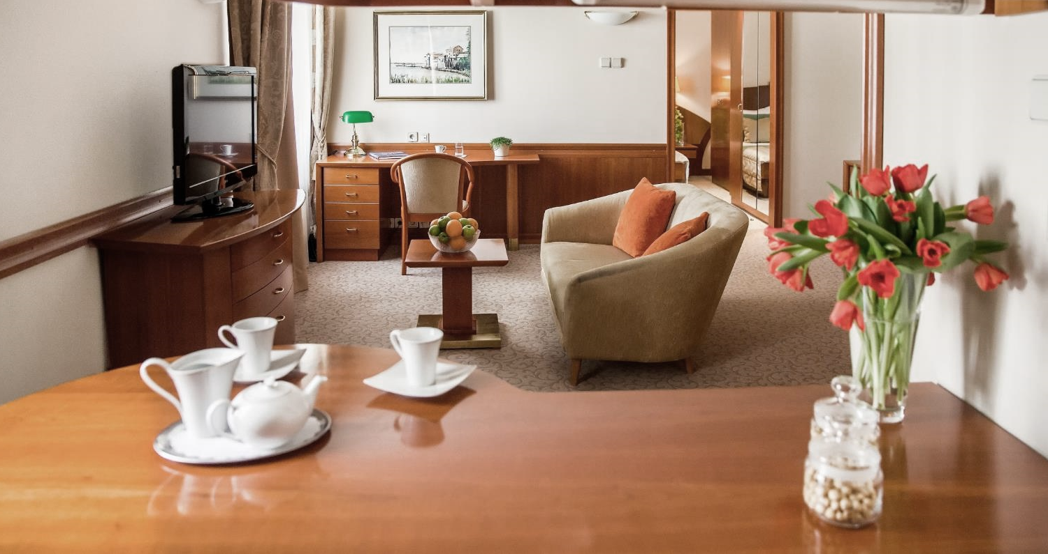
GRAND HOTEL UNION ROOMS • DECORATED WITH AN ETERNAL ELEGANCE
FAMILY TWO BEDROOM SUITE average size is 73 SqM/ 785 SqFt.
Notes:
SPACIOUS DELUXE ONE BEDROOM SUITE with king or 2 queen bed accommodation features a separate living room and sleeping bedroom. Suite has an elegant sitting area with comfortable arm chairs and sofas, spacious working space, flat screen TV with international channels and WIFI.
DELUXE FAMILY TWO BEDROOM
with twin bedding and converted sofa is perfect accommodation for the family. It features comfortable working space, flat screen TV with international channels and WIFI.

Slide 22
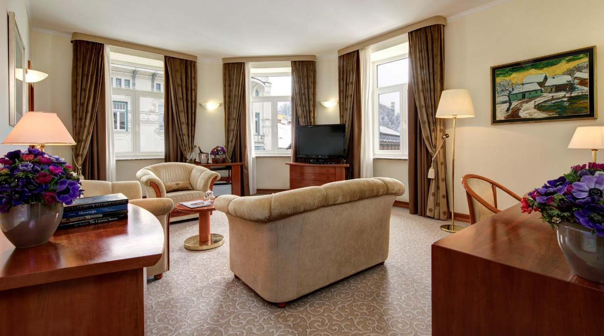
GRAND HOTEL UNION ROOMS • DECORATED WITH AN ETERNAL ELEGANCE
CORNER SUITE average size is 70 SqM/ 753 SqFt.
Notes:
Presidential Suite offers luxury accommodation with magnificent views of Triple Bridges. The 80 square meter suite features large living room with comfort sitting area, master bedroom and two of them also additional sleeping area.
Suite amenities
high speed wireless internet access,
flat screen TV with international channels,
comfortable arm chairs and sofas,
spacious working area.

Slide 23
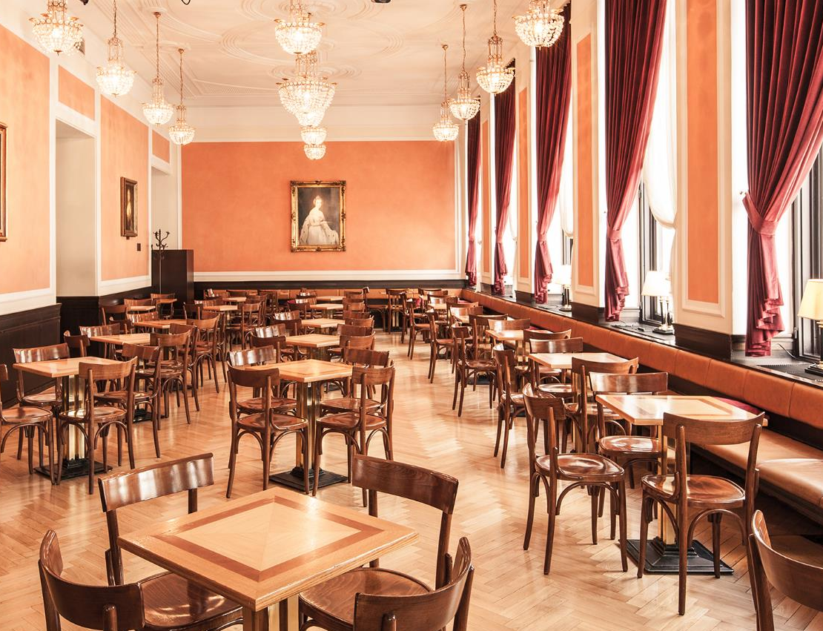
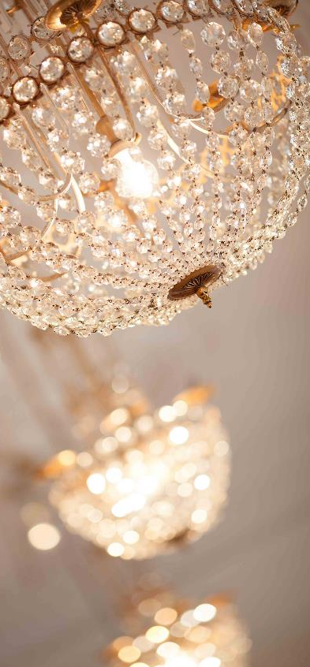
UNION HOTELS • CULINARY EXPERIENCE • UNION CAFE
UNION CAFE

Slide 24
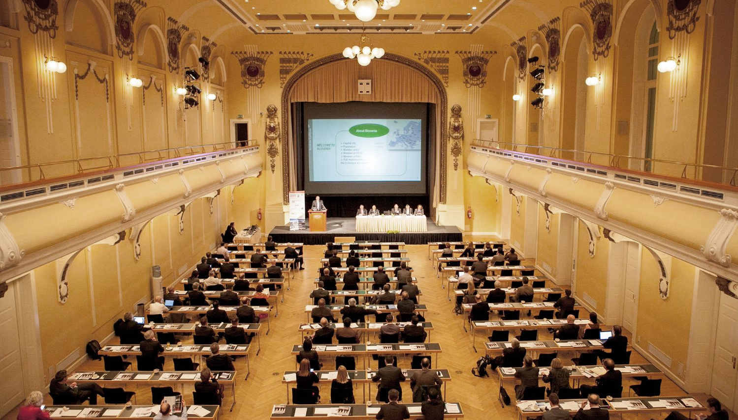
UNION HOTELS • GRAND HOTEL UNION • HALLS
GRAND UNION HALL

Slide 25
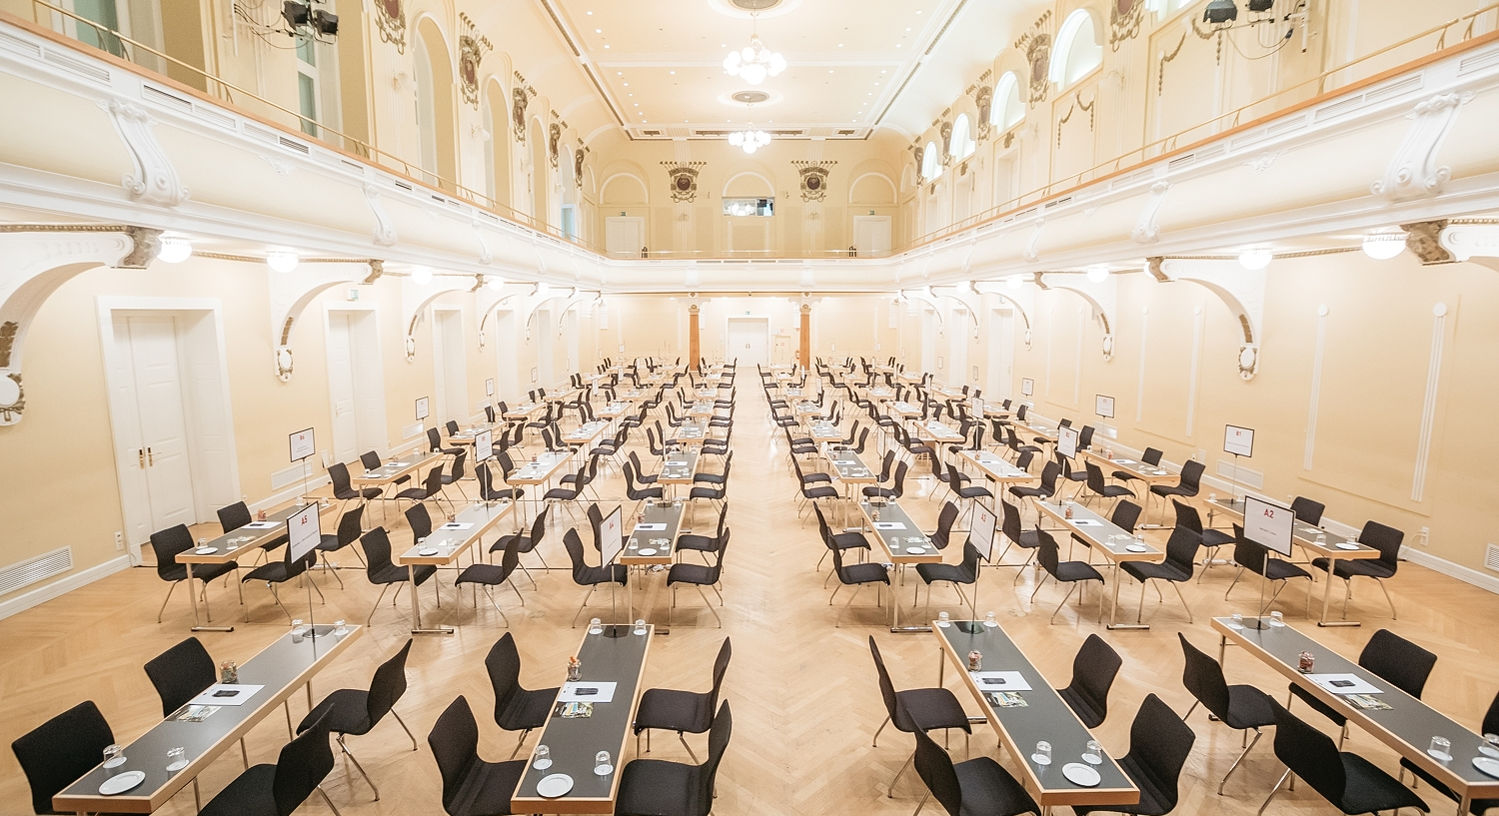
UNION HOTELS • GRAND HOTEL UNION • HALLS
GRAND UNION HALL

Slide 26
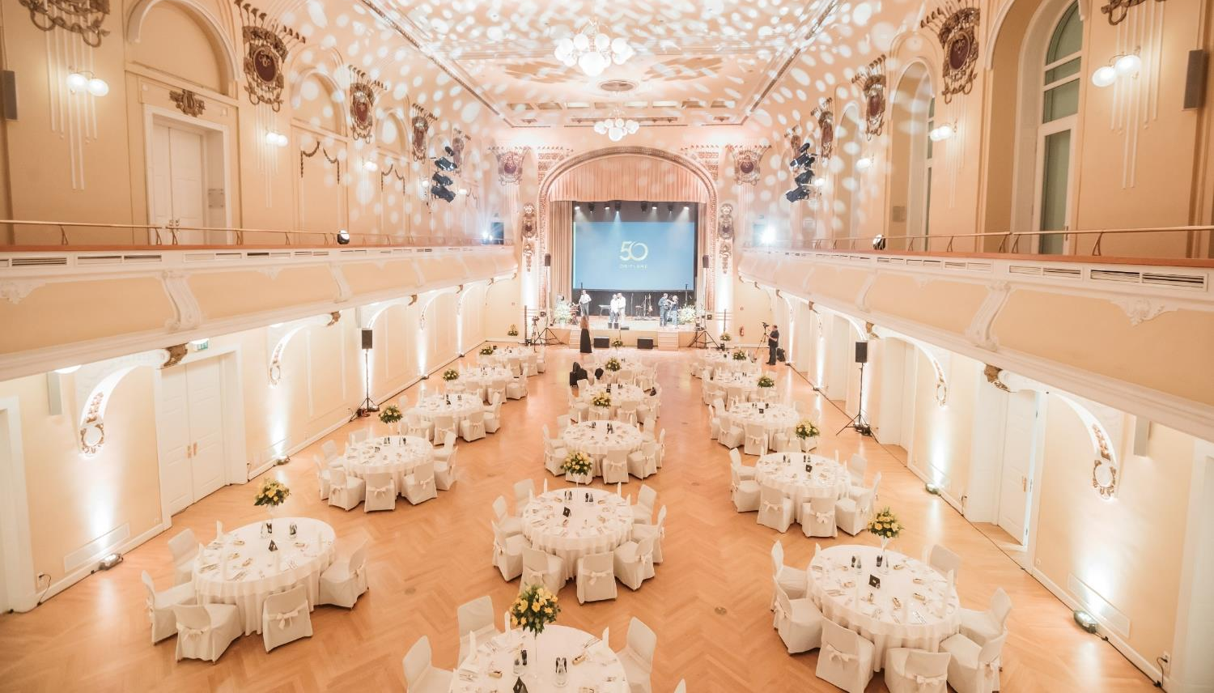
UNION HOTELS • GRAND HOTEL UNION • HALLS
GRAND UNION HALL

Slide 27
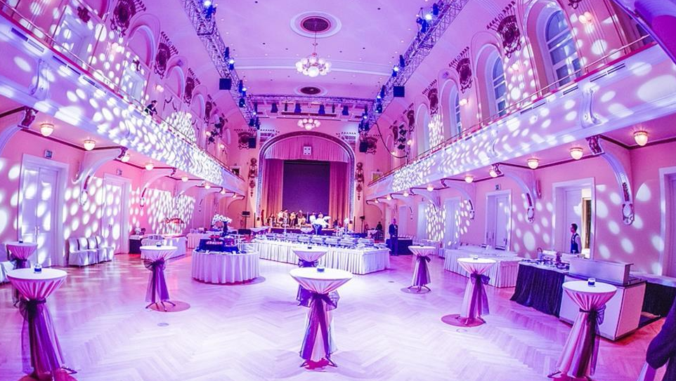
UNION HOTELS • GRAND HOTEL UNION • HALLS
GRAND UNION HALL

Slide 28
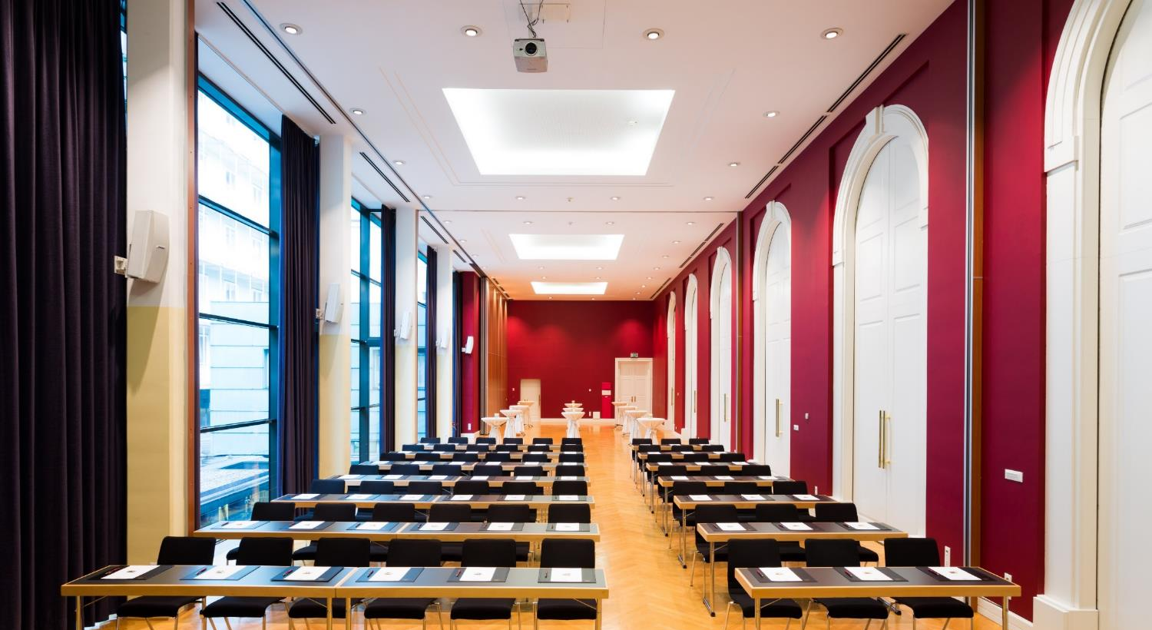
UNION HOTELS • GRAND HOTEL UNION • HALLS
GLASS HALL

Slide 29
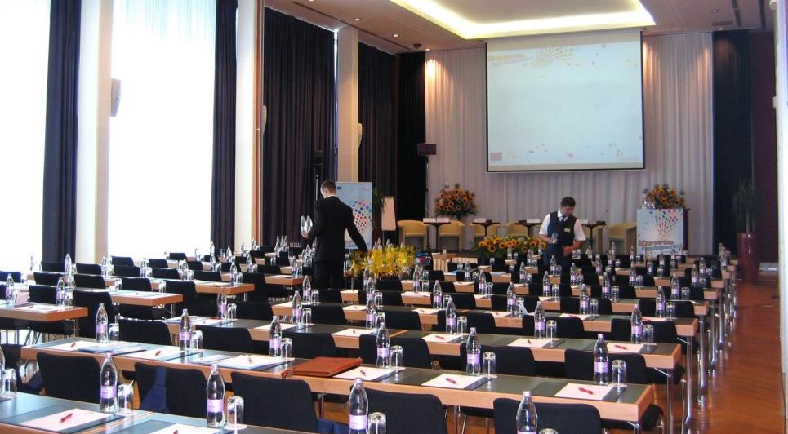
UNION HOTELS • GRAND HOTEL UNION • HALLS
WHITE HALL

Slide 30
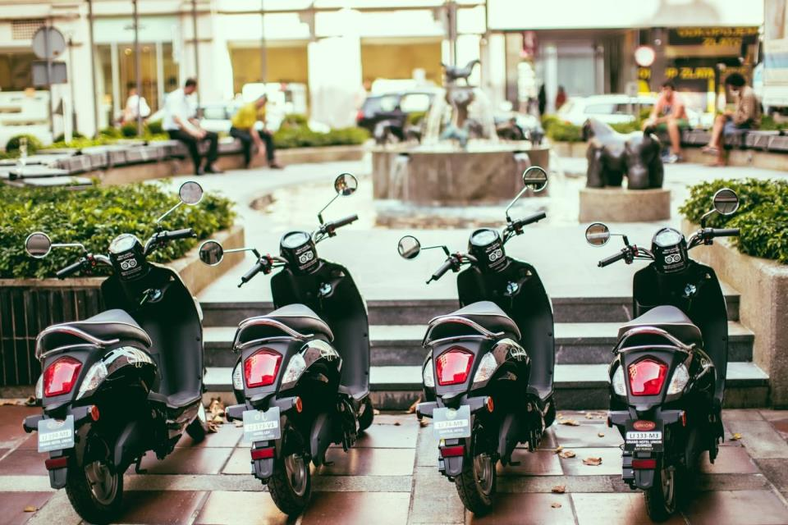
WELCOME TO THE uHOTEL
www.uhotel.si

Slide 31
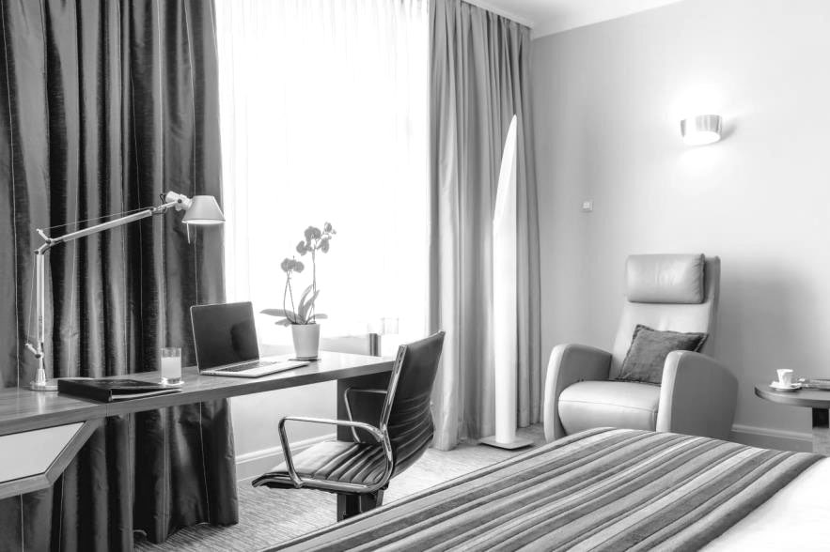
uHOTEL • WHERE BUSINESS MEETS COMFORT
220 COMFORTABLE AND ELEGANTLY FURNISHED ROOMS
120 SECURED PARKING SPACES
SPA & WELLNESS
F&B OUTLETS
18 CONFERENCE HALLS AND SALONS OFFERING OVER 2.200 m²
* FULL AV SUPPORT & PROFESSIONAL STAFF

Slide 32
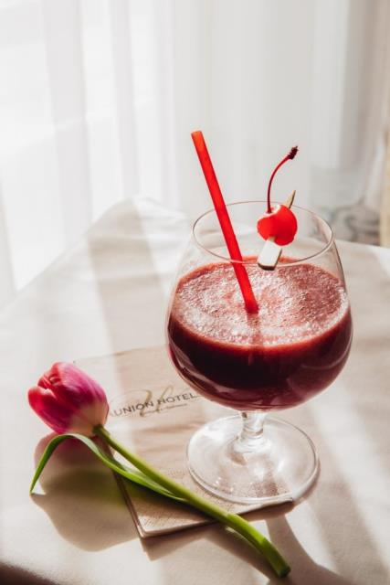
UNION HOTELS • uHOTEL • ROOM TYPES
EXECUTIVE QUEEN (65)
EXECUTIVE ROOM (59)
STUDIO ROOM (50)
STUDIO CASTLE VIEW (28)
JUNIOR SUITE (6)
CASUAL SUITE (6)
EXECUTIVE SUITE (6)
4 ROOMS CURRENTLY BEING REFURBISHED

Slide 33
uHOTEL • ROOM TYPES • BUSINESS & RELAX
EXECUTIVE QUEEN average size is 26 SqM / 280 SqFt.

Slide 34
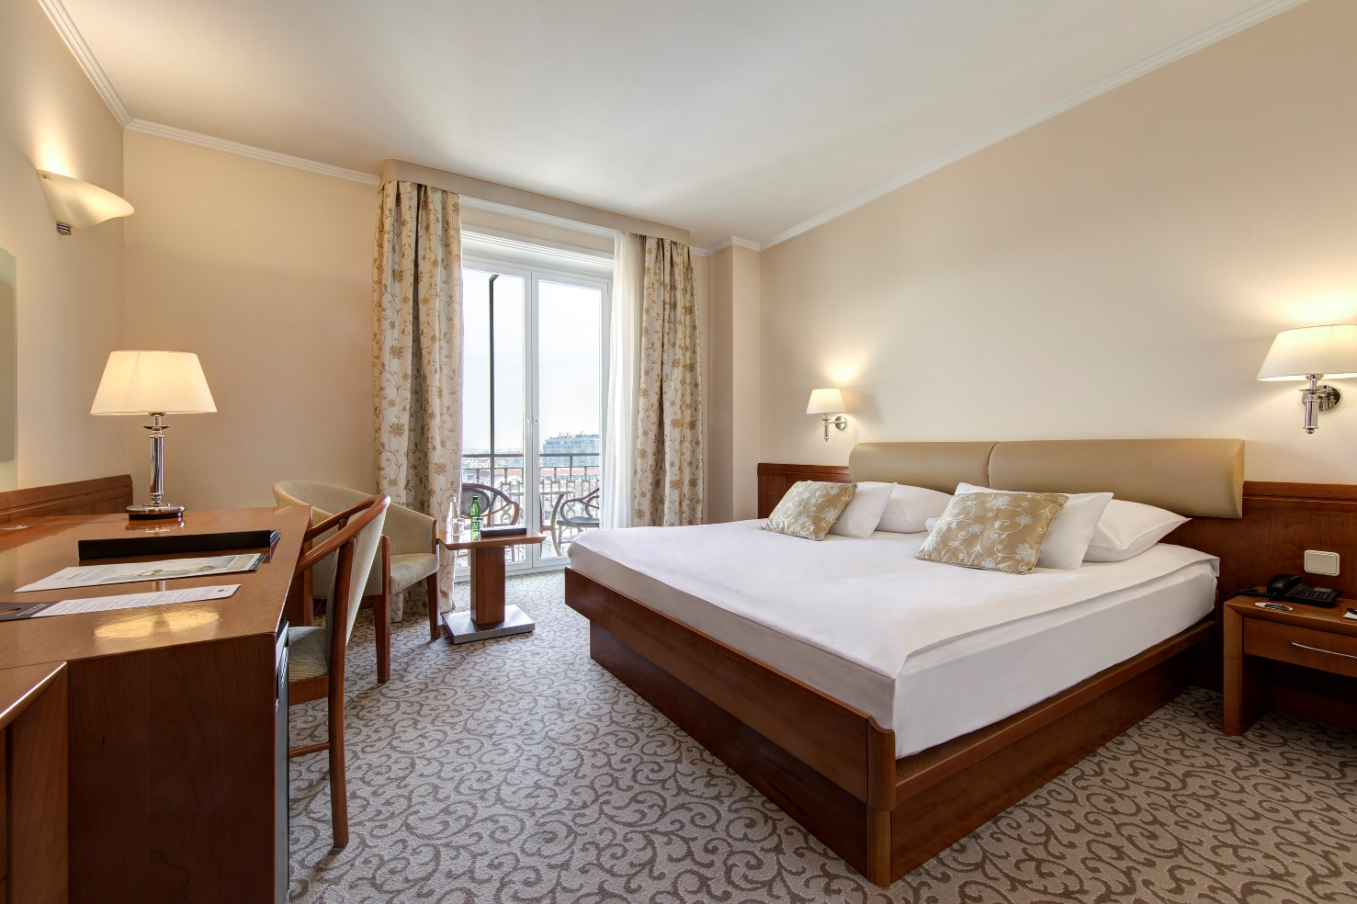
uHOTEL • ROOM TYPES • BUSINESS & RELAX
EXECUTIVE ROOM average size is 29 SqM / 312 SqFt.

Slide 35
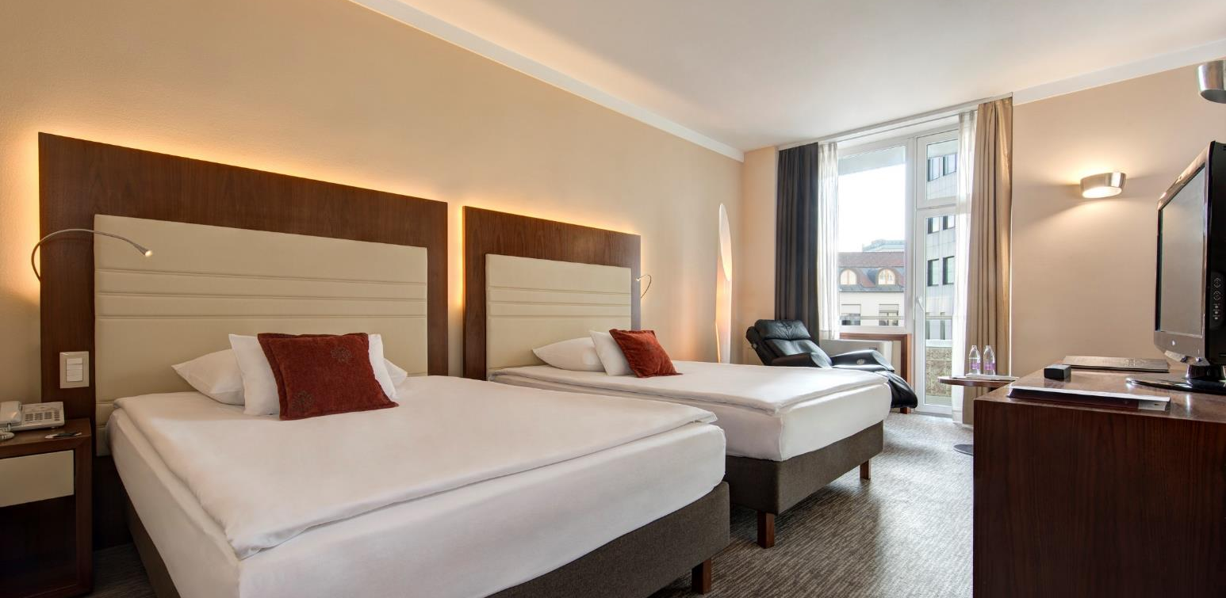
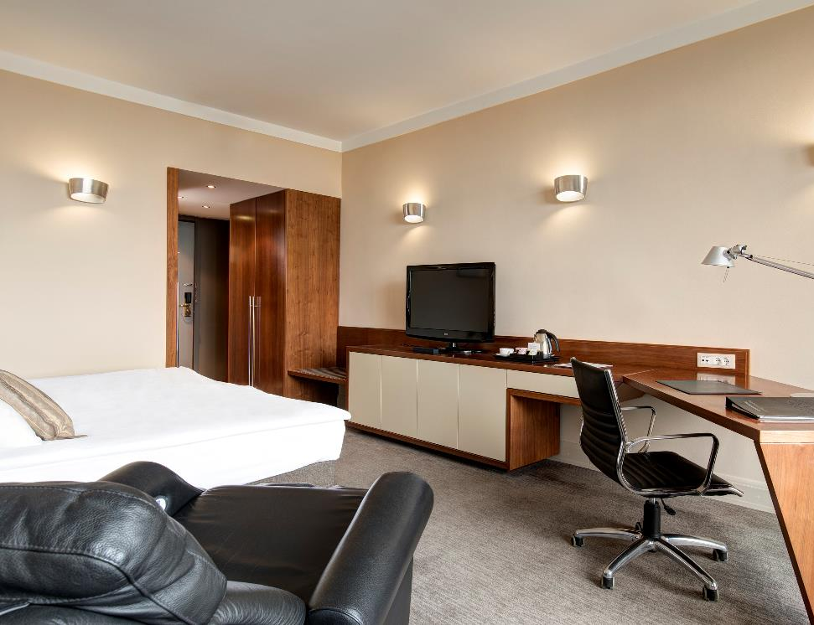
uHOTEL • ROOM TYPES • BUSINESS & RELAX
STUDIO ROOM average size is 32 SqM / 344SqFt.

Slide 36
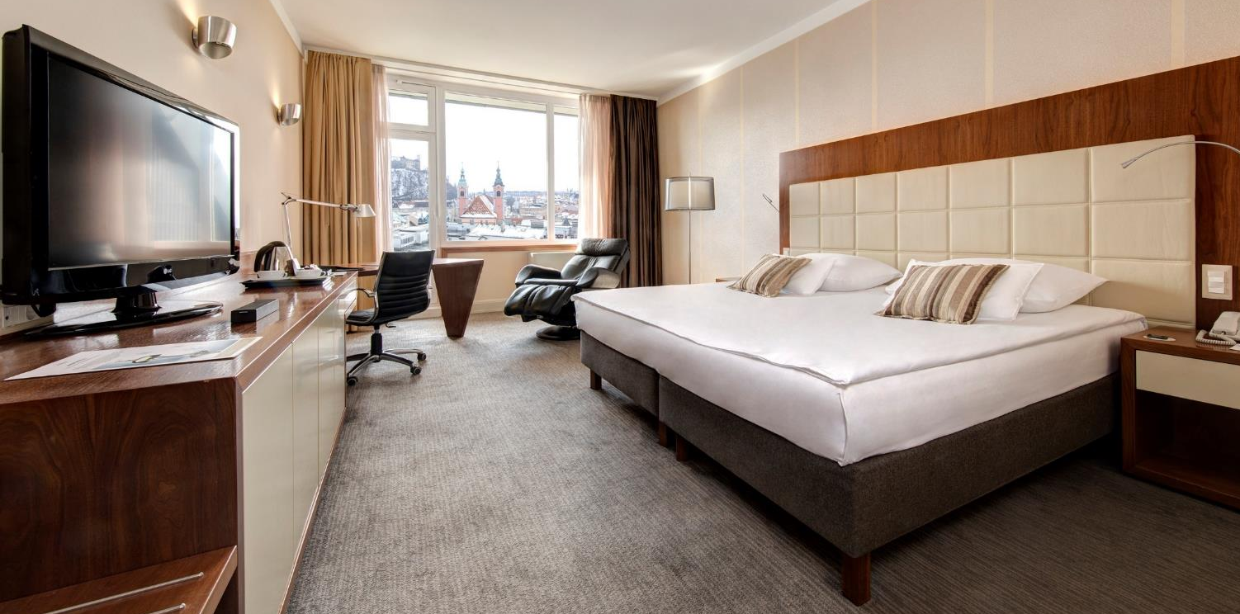
uHOTEL • ROOM TYPES • BUSINESS & RELAX
STUDIO CASTLE VIEW average size is 29 SqM/ 312 SqFt.

Slide 37
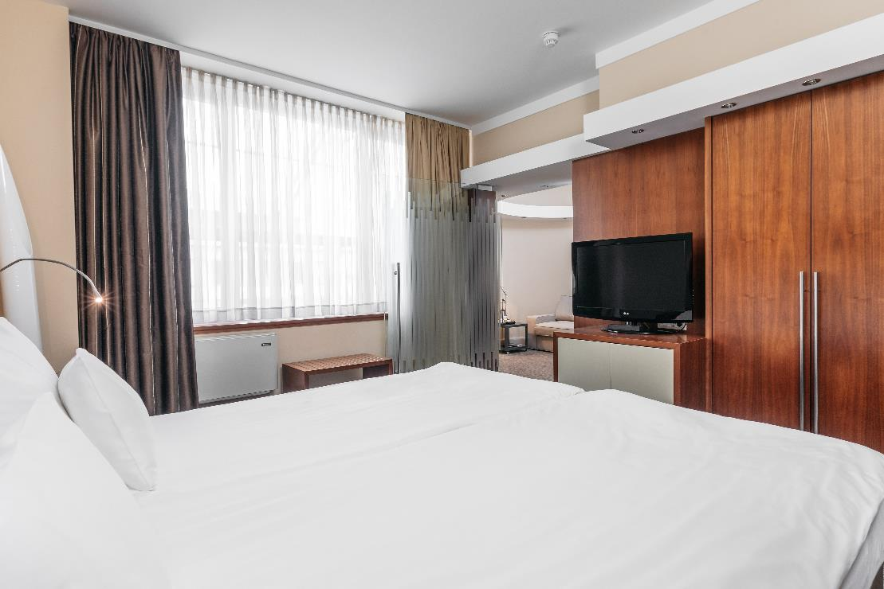
uHOTEL • ROOM TYPES • BUSINESS & RELAX
JUNIOR SUITE average size is 34 m² / 366 sqft.

Slide 38
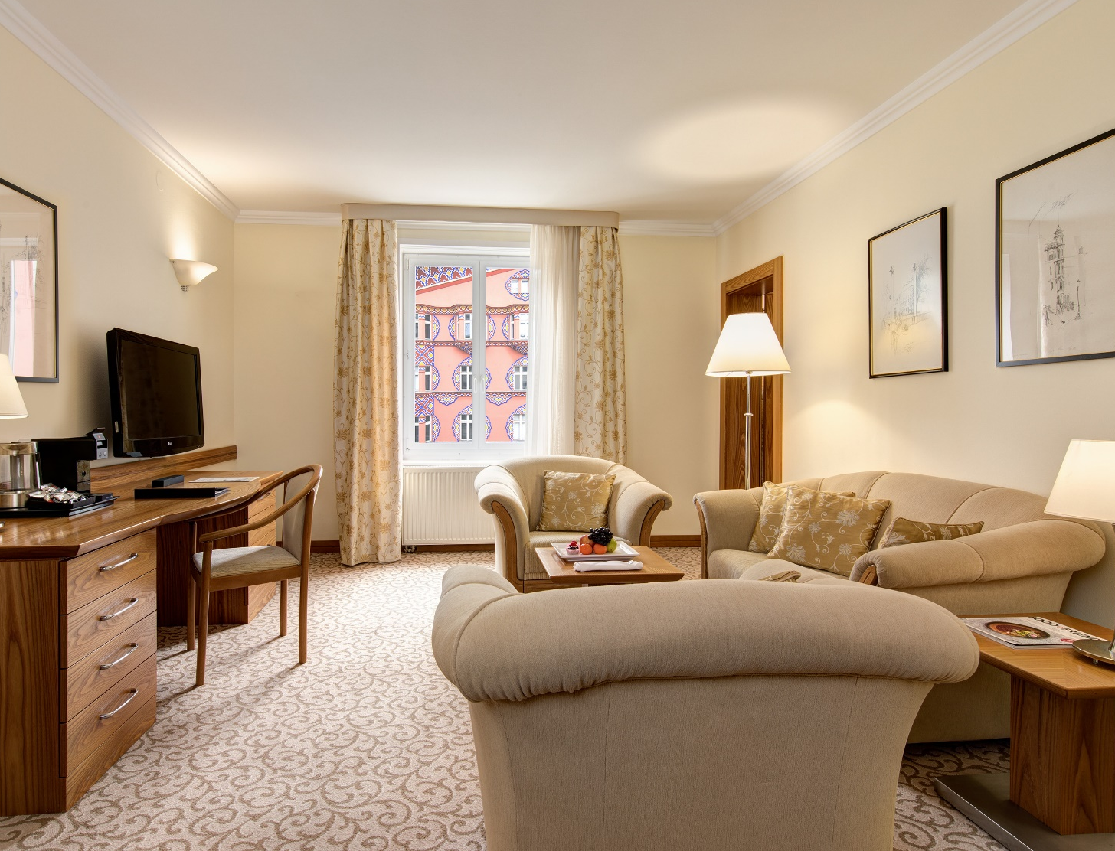
uHOTEL • ROOM TYPES • BUSINESS & RELAX
CASUAL SUITE average size is 51 m²/ 550 SqFt.

Slide 39
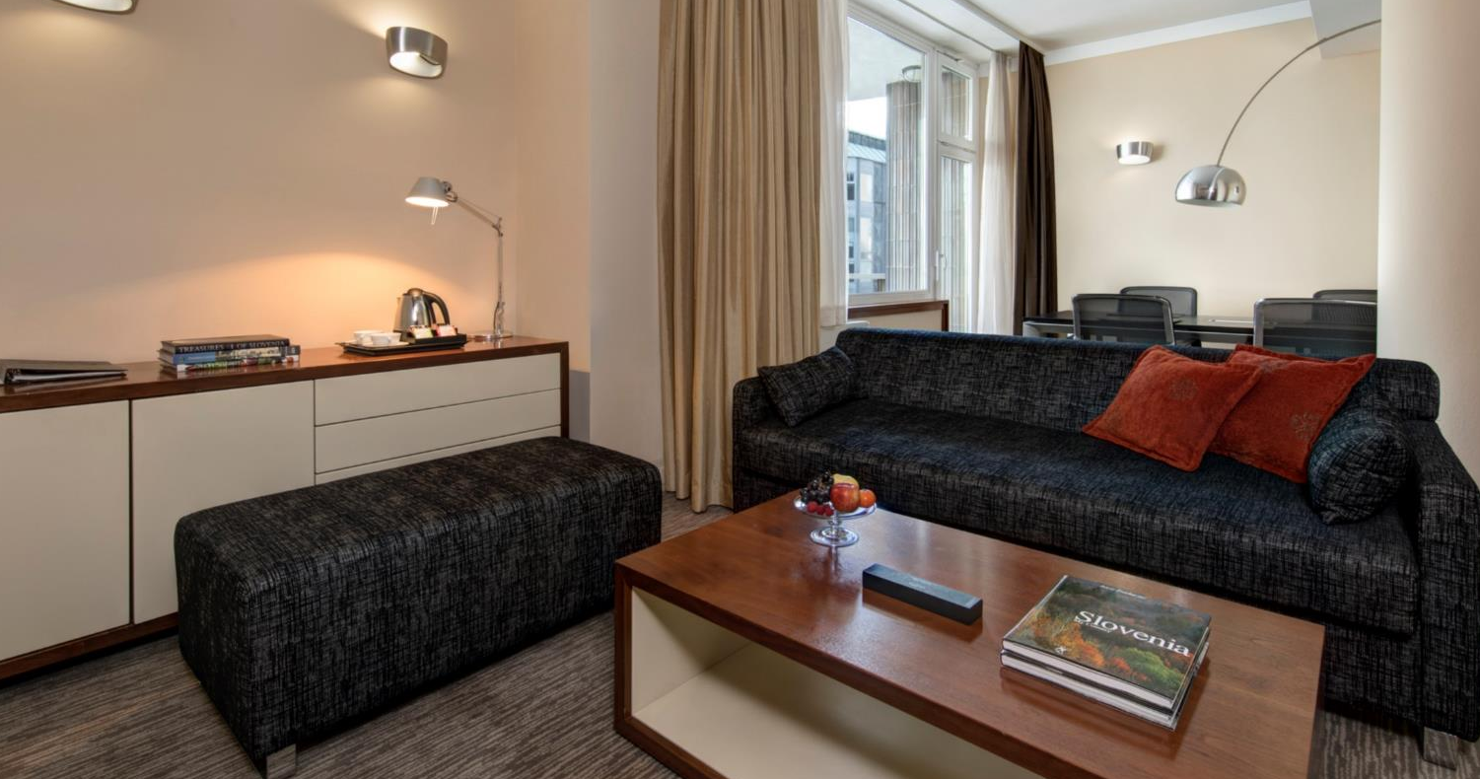
uHOTEL • ROOM TYPES • BUSINESS & RELAX
EXECUTIVE SUITE average size is 73 m²/796 SqFt.

Slide 40
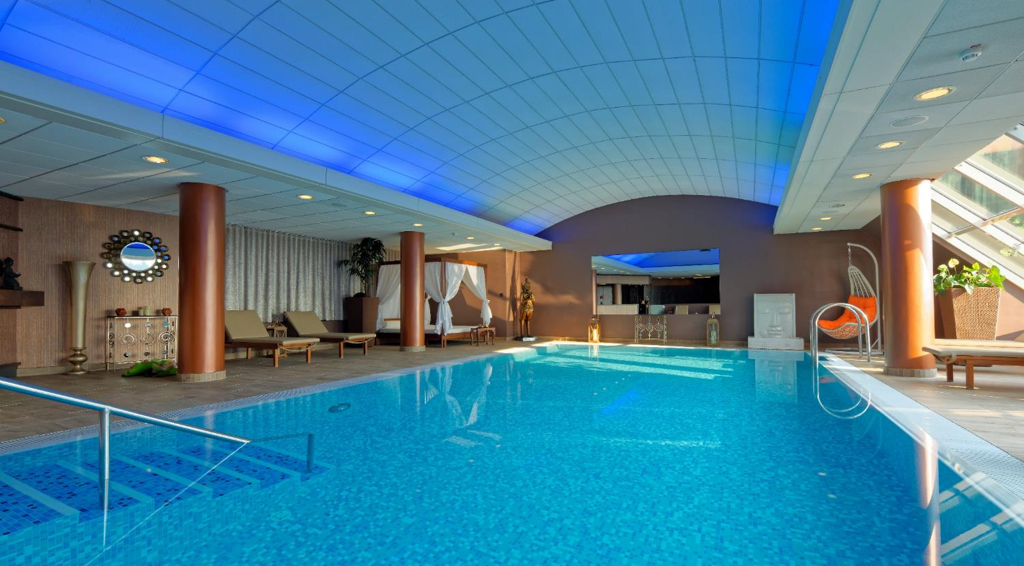
UNION HOTELS • uHOTEL • WELLNESS
SENSE WELLNESS – PENTHOUSE POOL

Slide 41
uHOTEL • F&B OUTLETS
CULINARY DELIGHTS AT BUSINESS LOUNGE BAR AND UNION GARDEN

Slide 42
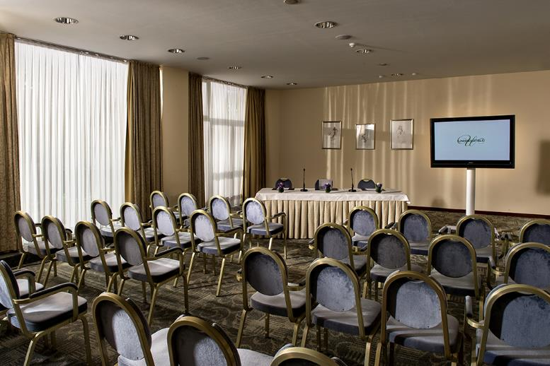
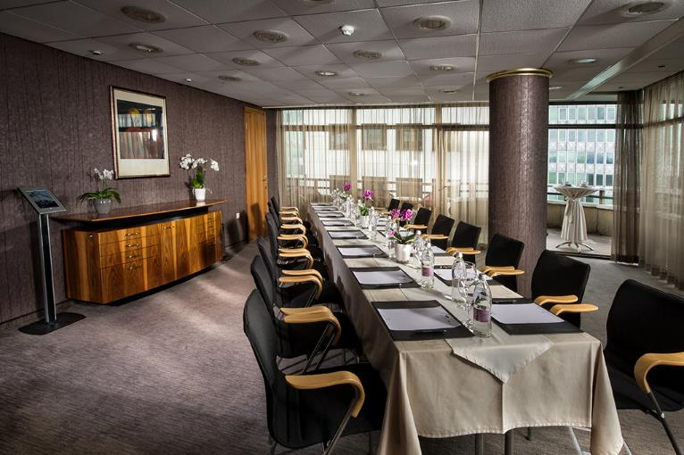
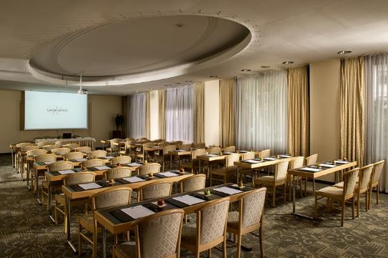
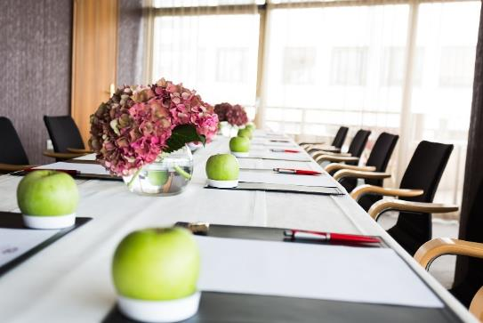
UNION HOTELS • uHOTEL • SALONS

Slide 43
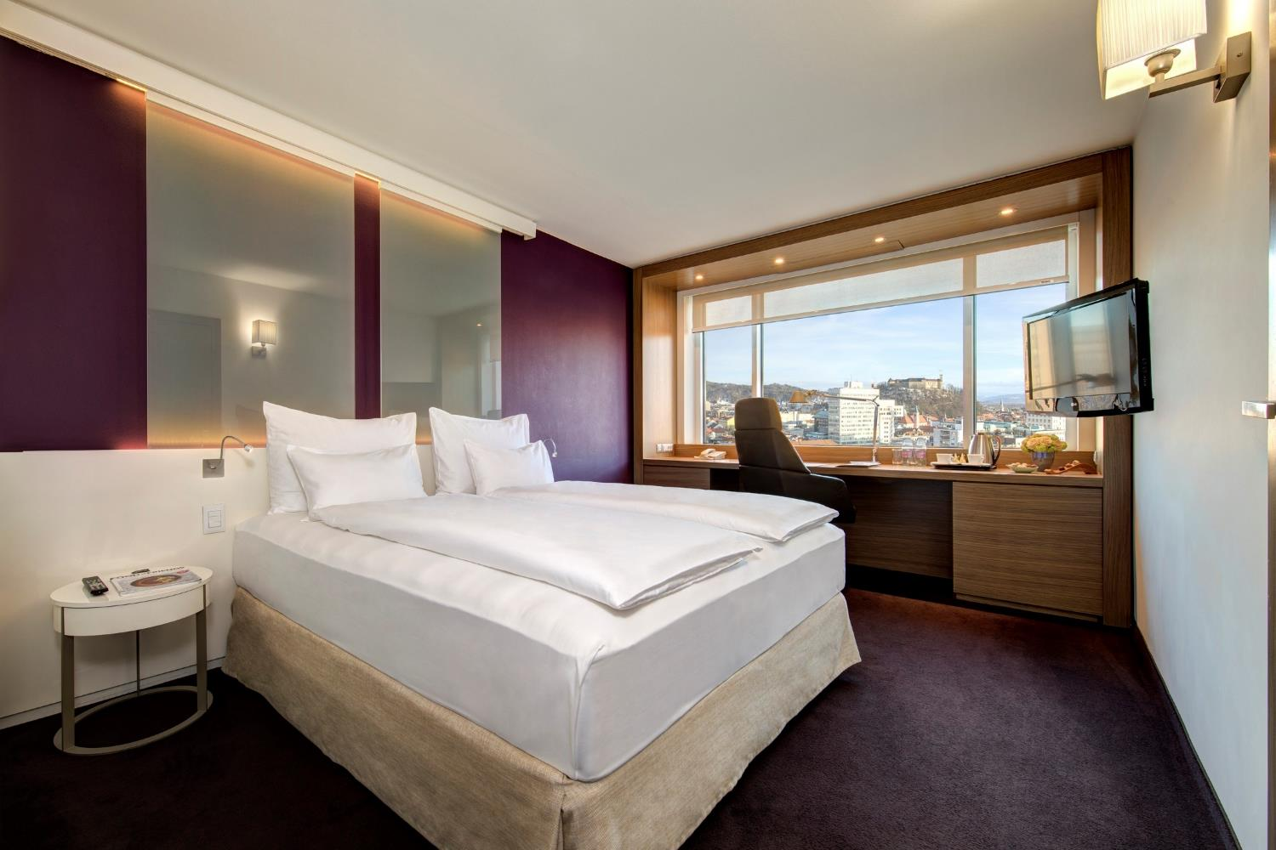
WELCOME TO THE HOTEL LEV
www.union-hotels.eu
www.hotellev.si

Slide 44
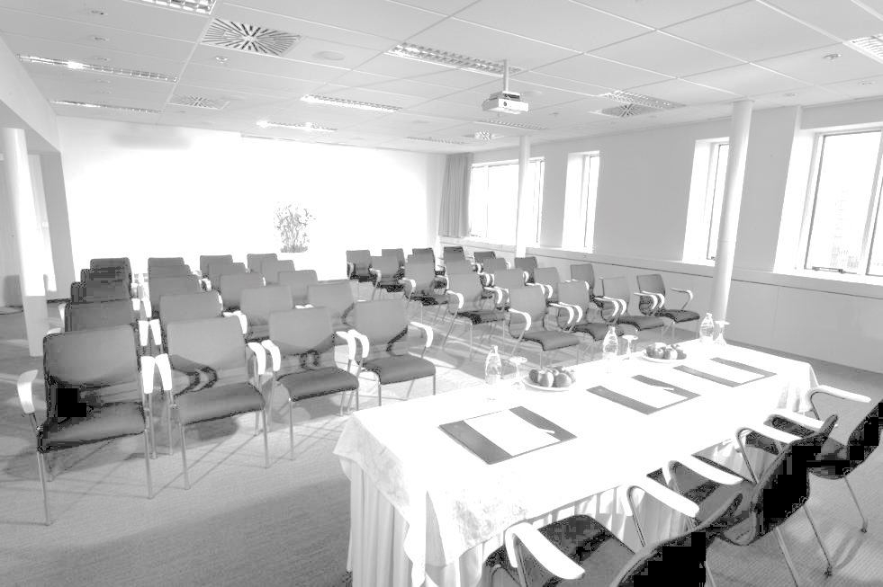
HOTEL LEV • IN THE HEART OF THE CITY
209 COMFORTABLE ROOMS
SECURED PARKING
CONFERENCE HALL KARANTANIJA, TEHNOLEV
L BISTO & BAR
FULL AV SUPPORT & PROFESSIONAL STAFF

Slide 45
UNION HOTELS • HOTEL LEV • ROOM TYPES
CLASSIC DOUBLE/ TWIN (51)
PREMIER DOUBLE (94) NEW
EXECUTIVE QUEEN (10)
EXECUTIVE DOUBLE CASTLE VIEW (24)
JUNIOR SUITE (12)
EXECUTIVE SUITE (4)
PREMIER SUITE (14) NEW
22 ADDITIONAL PREMIER ROOMS WILL
BE ADDED IN APRIL 2020

Slide 46
UNION HOTELS • HOTEL LEV • ROOM TYPES
CLASSIC DOUBLE / TWIN average size is app. 23 SqM/251 SqFt.

Slide 47
UNION HOTELS • HOTEL LEV • ROOM TYPES
Contemporary-design, charming bathrooms with a raindrop shower,
laptop-sized safes, soft lounge seating by the windows, Smart TV, Wi-Fi …
PREMIER DOUBLE average size is 22 SqM/236 SqFt.
Notes:
ROOM AMENITIES
Premier Doubles (20.6 m² / 222 sqft) ) are the newly renovated rooms of Hotel Lev with an open-space design, transparent glass instead of bathroom walls, as well as smooth and soft colours, ensuring guests a relaxed and trendy stay.

Slide 48
UNION HOTELS • HOTEL LEV • ROOM TYPES
N
O
U
V
E
A
U
NEU!
Open-space design, transparent glass instead of bathroom walls, smooth and soft colours,
ensuring guests a relaxed and trendy stay.
PREMIER DOUBLE average size is 22 SqM/236 SqFt.
Notes:
ROOM AMENITIES
Contemporary-design rooms with a double bed are furnished with charming bathrooms with a raindrop shower, select Prija bathroom cosmetics, laptop-sized safes, soft lounge seating by the windows, Wi-Fi and flat-screen TVs.

Slide 49
UNION HOTELS • HOTEL LEV • ROOM TYPES
.
EXECUTIVE QUEEN average size is 20 SqM/218 SqFt.
Notes:
ROOM AMENITIES
Modern furnished rooms feature a queen size bed, large working area with ergonomic chair, black out panel curtains, LCD screen and high speed internet.

Slide 50
UNION HOTELS • HOTEL LEV • ROOM TYPES
EXECUTIVE DOUBLE CASTLE VIEW average size is 23 SqM/251 SqFt.

Slide 51
UNION HOTELS • HOTEL LEV • ROOM TYPES
JUNIOR SUITE average size is 37 SqM/403 SqFt.
Notes:
ROOM AMENITIES
Rooms feature a separate sitting area and comfortable working area, LCD television and high speed internet connection.

Slide 52
UNION HOTELS • HOTEL LEV • ROOM TYPES
EXECUTIVE SUITE average size is 37 SqM/403 SqFt.
Notes:
ROOM AMENITIES
Executive suite feature a separate sitting area, king bed accommodation, comfortable working area with ergonomic chair, black out panel curtains, LCD screen and high speed internet.

Slide 53
UNION HOTELS • HOTEL LEV • ROOM TYPES
PREMIER SUITE average size is 33 SqM /355 SqFt.
Notes:
ROOM AMENITIES
Executive suite feature a separate sitting area, king bed accommodation, comfortable working area with ergonomic chair, black out panel curtains, LCD screen and high speed internet.

Slide 54
UNION HOTELS • HOTEL LEV • NEW F&B OUTLETS
NEW L Bistro & Bar

Slide 55
HOTEL LEV • CONFERENCES & MEETINGS • KARANTANIJA
EVENING SET UP @KARANTANIJA HALL

Slide 56
HOTEL LEV • CONFERENCES & MEETINGS • TEHNOLEV
TEHNOLEV

Slide 57
WELCOME TO THE CENTRAL HOTEL
www.centralhotel.si

Slide 58
UNION HOTELS • CENTRAL HOTEL • ROOM TYPES
COMFY DOUBLE (24)
ROOMY DOUBLE (49)
SPACIOUS DOUBLE (10)
CASTLE VIEW DOUBLE (7)
CAPSULE (10)

Slide 59
CENTRAL HOTEL • THE VIBRANT SIDE OF LJUBLJANA
COMPLETELY RENOVATED IN APRIL 2019
90 NEW FRESH AND TRENDY ROOMS
TOP FLOOR LIVING LOBBY AND BAR
MOBILE APP FOR MOBILE CHECK-IN AND KEYLESS ENTRY
SECURED PARKING

Slide 60
UNION HOTELS • CENTRAL HOTEL • ROOM TYPES
Contemporary, entry-level accommodation featuring double bed and open bathroom concept
COMFY DOUBLE average size is 16 SqM / 170SqFt

Slide 61
UNION HOTELS • CENTRAL HOTEL • ROOM TYPES
Contemporary, mid-level accommodation featuring double bed and open bathroom concept
ROOMY DOUBLE average size is 20 SqM / 220 SqFt

Slide 62
UNION HOTELS • CENTRAL HOTEL • ROOM TYPES
XL all the way featuring double bed and open bathroom concept
SPACIOUS DOUBLE average size is 24 SqM / 260 SqFt

Slide 63
UNION HOTELS • CENTRAL HOTEL • ROOM TYPES
The Castle View room featuring double bed and open bathroom concept
CASTLE VIEW DOUBLE average size is 20 SqM / 220 SqFt

Slide 64
CENTRAL HOTEL • ROOFTOP @CENTRAL
The 7th floor multifuncional living area with the check-in, bar & restaurant, breakfast area…
ROOFTOP@CENTRAL

Slide 65
CENTRAL HOTEL • THE VIBRANT SIDE OF LJUBLJANA
… with an exceptional view of the city
TERRACE OF ROOFTOP@CENTRAL

Slide 66
CENTRAL HOTEL • THE VIBRANT SIDE OF LJUBLJANA
The hotel mobile APP that
connects the guest
with the hotel services
during their stay;
Overview of bookings and hotel services,
Express Check-in,
Mobile Key to unlock the hotel room,
Room Payment
Express Check-out
THE HOTEL MOBILE APP

Slide 67
UNION HOTELS • IN THE CITY CENTRE OF LJUBLJANA • SLOVENIA
THANK YOU!
Q&A?
www.uhcollection.si
MARKO ZIDAR | Sales Associate
Union hoteli d.d., T. +386 31 342 596, marko.zidar@uhcollection.si

Slide 68
FUNCTION SPACE • CAPACITY

Slide 69
FUNCTION SPACE • CAPACITY

